Slide 1
Chapter 2

Slide 2
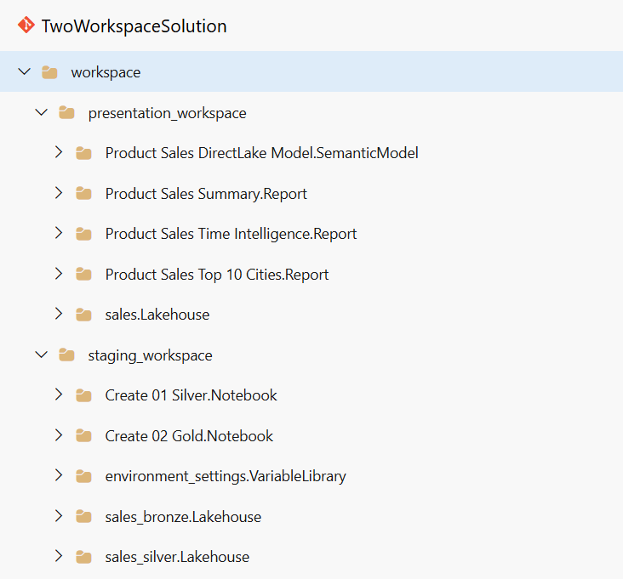
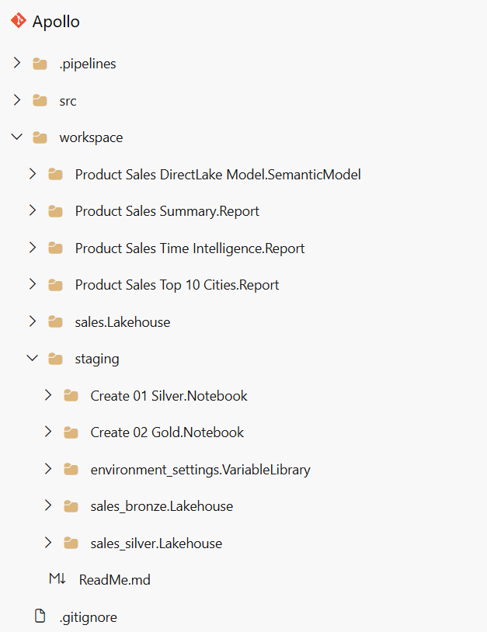

Slide 3
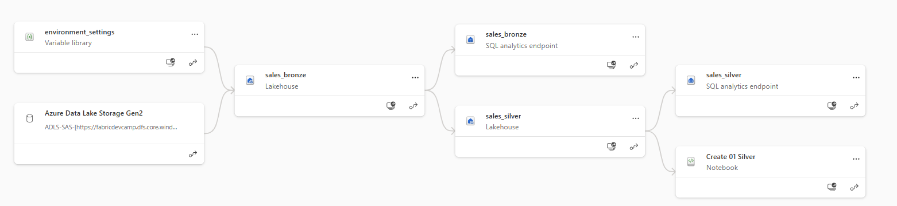
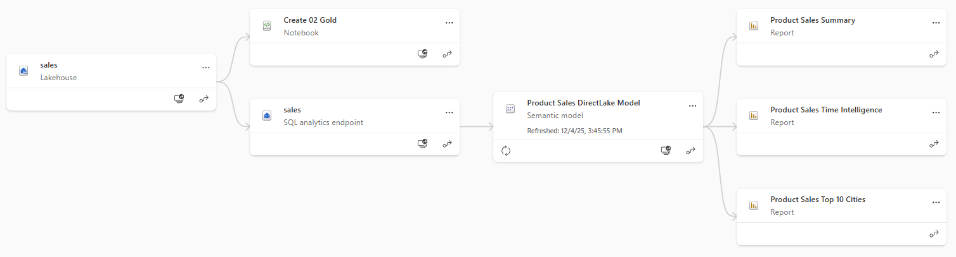

Slide 7
Developer 1
merge changes
shared
codebase
Developer 2
merge changes
Developer N
merge changes

Slide 8
dev
test
prod

Slide 9
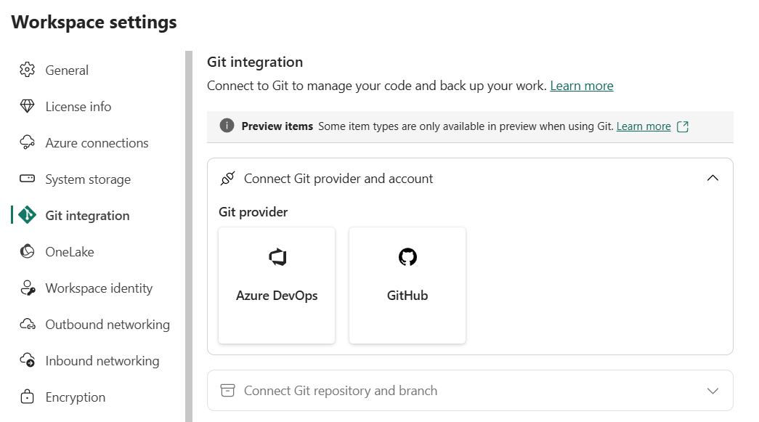

Slide 10
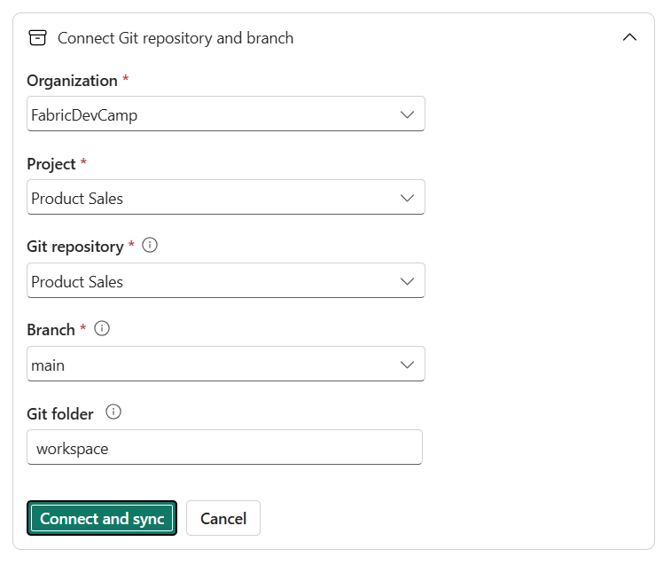

Slide 11
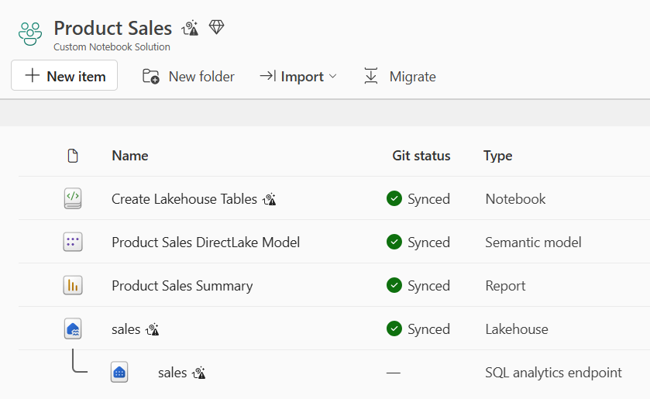

Slide 12
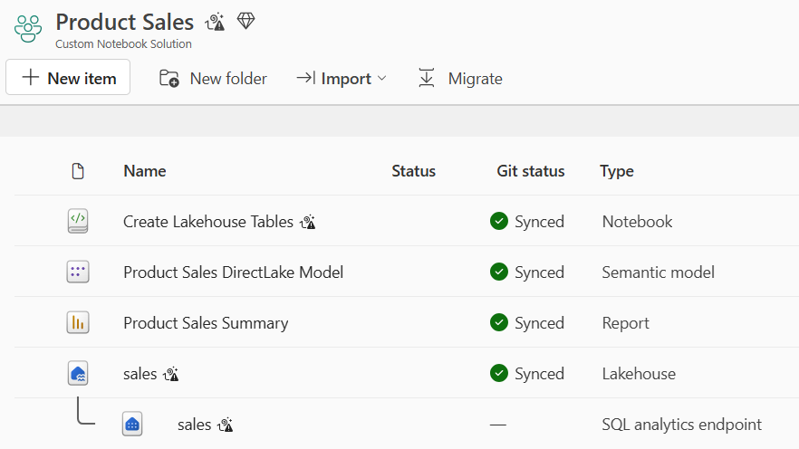
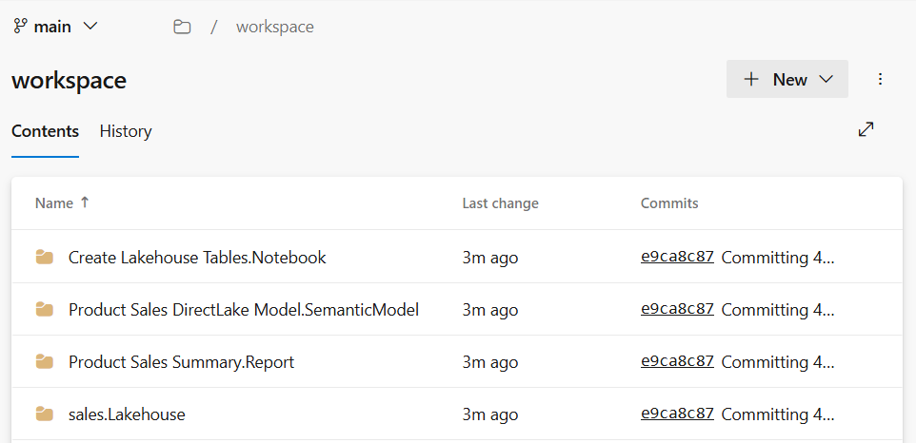
Sync to Git

Slide 13
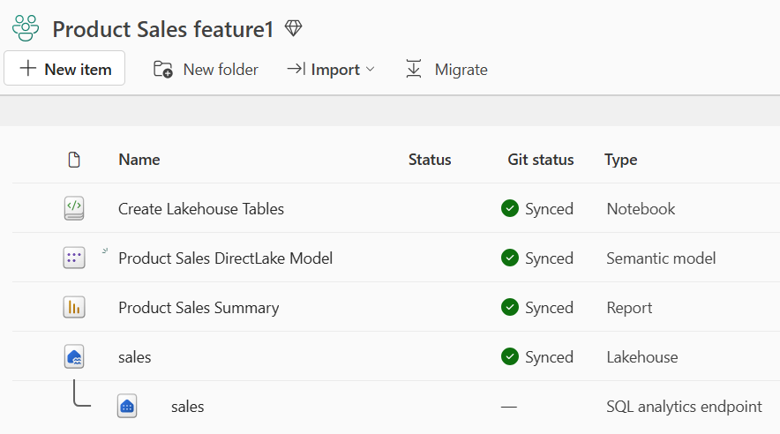
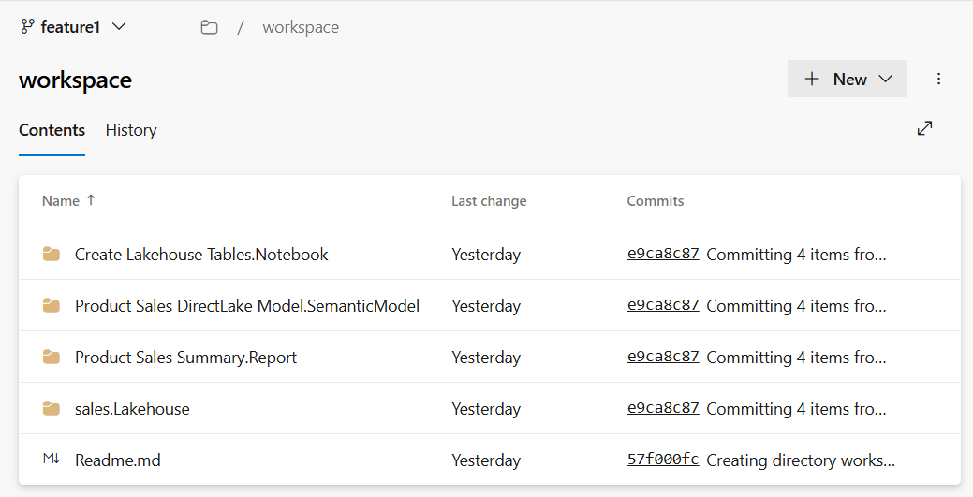
Sync to Workspace

Slide 14
feature 1
workspace
feature 1
branch
integration
branch
2-way sync
merge
feature 2
workspace
feature 2
branch
2-way sync
merge
feature N
workspace
feature N
branch
2-way sync
merge

Slide 15
Prod
workspace
feature
workspace
feature
branch
main
branch
feature
workspace
feature
branch

Slide 16
Dev
workspace
Test
workspace
Prod
workspace
feature
workspace
feature
branch
dev
branch
test
branch
main
branch
feature
workspace
feature
branch

Slide 17
Fabric Deployment Pipeline
dev
workspace
test
workspace
prod
workspace
Deploy
Deploy

Slide 18
Fabric Deployment Pipeline
dev
workspace
test
workspace
prod
workspace
Deploy
Deploy
GIT
SYNC
feature
workspace
feature
branch
main
branch
feature
workspace
feature
branch

Slide 19
workspace
Notebook
Pipeline
Variable Library
Copyjob
var1 - string - 'foo'
var2 - string - 'bar'
var3 - integer - 42
Dataflow
OneLake Shortcut

Slide 20


dev
workspace
test
workspace
prod
workspace

Slide 21
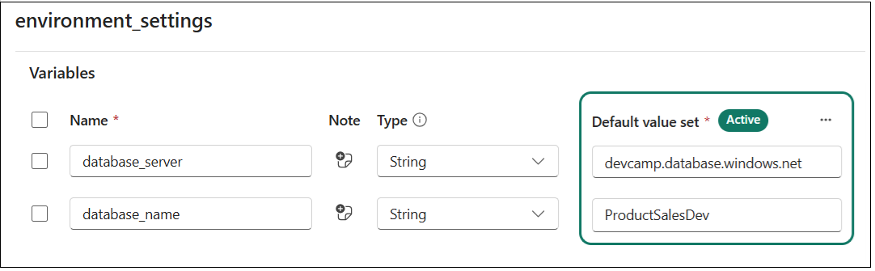

Slide 22
Variable Name | Type | Default Value
database_server | String | devcamp.database.windows.net
database_name | String | product-sales-dev

Slide 23
Variable Library
Value Sets
Variable Name | Type | Default Value
database_server | String | dev value
database_name | String | dev value
test
test value
test value
prod
prod value
prod value

Slide 24
dev workspace
test workspace
prod workspace
Variable Library
Variable Library
Variable Library
default value set (active)
test value set
prod value set
default value set
test value set (active)
prod value set
default value set
test value set
prod value set (active)

Slide 25
Workspace Item Types by Workload
Data Factory
Data Engineering
Power BI
DataPipeline
Lakehouse
SemanticModel
Dataflow
Notebook
Report

Slide 26
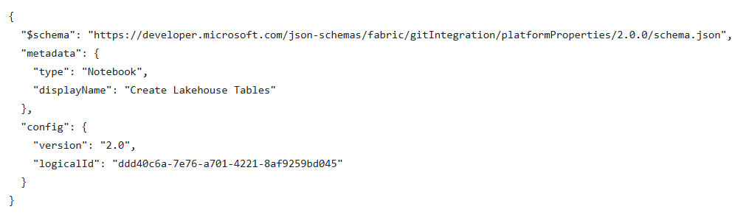

Slide 27
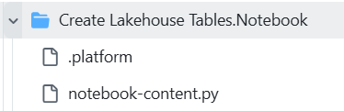
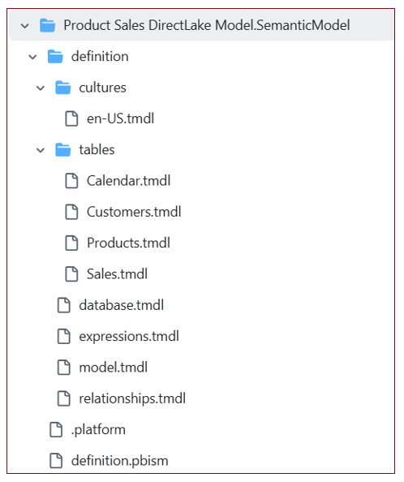
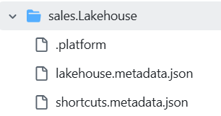

Slide 28
feature workspace
dev workspace
prod workspace
Workspace Item
Workspace Item
Workspace Item
displayName | sales
type | Lakehouse
id | 11111111-1111-1111-1111-111111111111
displayName | sales
type | Lakehouse
id | 22222222-2222-2222-2222-222222222222
displayName | sales
type | Lakehouse
id | 33333333-3333-3333-3333-333333333333
feature workspace
dev workspace
prod workspace
Workspace Item
Workspace Item
Workspace Item
displayName | sales
type | Lakehouse
id | 11111111-1111-1111-1111-111111111111
logicalId | AAAAAAAA-AAAA-AAAA-AAAA-AAAAAAAAAAAA
displayName | sales
type | Lakehouse
id | 22222222-2222-2222-2222-222222222222
logicalId | AAAAAAAA-AAAA-AAAA-AAAA-AAAAAAAAAAAA
displayName | sales
type | Lakehouse
id | 33333333-3333-3333-3333-333333333333
logicalId | AAAAAAAA-AAAA-AAAA-AAAA-AAAAAAAAAAAA

Slide 29
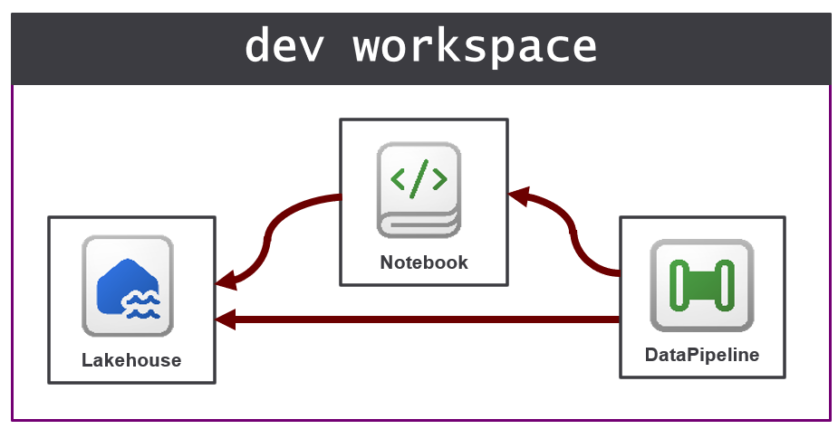
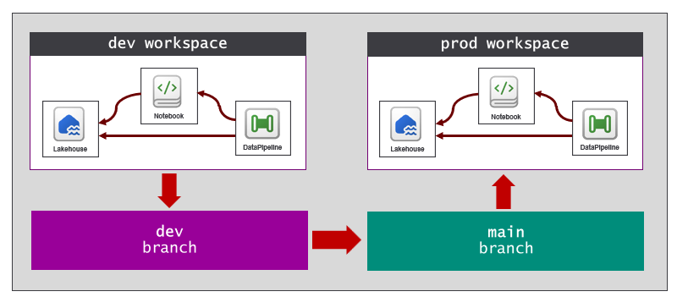
Images need to be recreated in PPT objects

Slide 30
CI/CD Task 1
API call
Microsoft Azure Fabric REST APIs
CI/CD Task 2
API call
Fabric REST APIs
CI/CD Task 3
API call
Power BI REST APIs
CI/CD Task 4
API call
Tabular Object Model (TOM)
CI/CD Task 5
API call
Azure Data Lake Storage (ADLS) Gen2 APIs
CI/CD Task 6
API call
Azure DevOps Services REST API
CI/CD Task 7
API call
GitHub REST APIs

Slide 31

Azure DevOps
Fabric Environment
Fabric Workspace
Azure
Pipeline
Fabric Notebook
Run Notebook

Slide 32
Item
Definition
Create Item
Fabric
REST
APIs
Item
Definition
Update Item Definition
Item
Definition
Get Item Definition

Slide 33
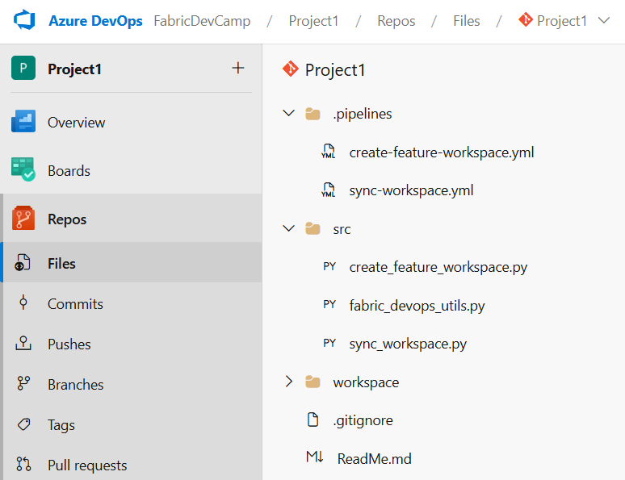

Slide 34
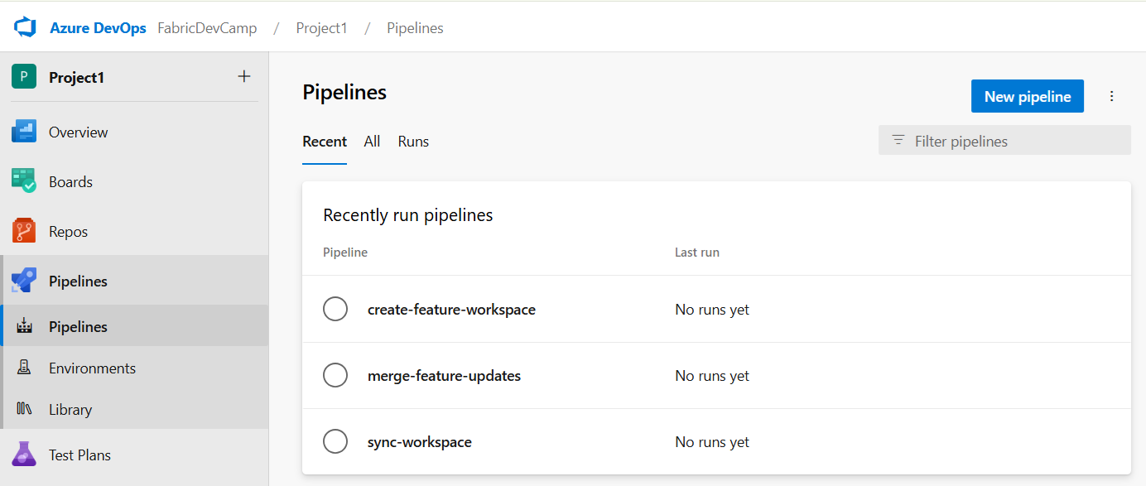

Slide 35
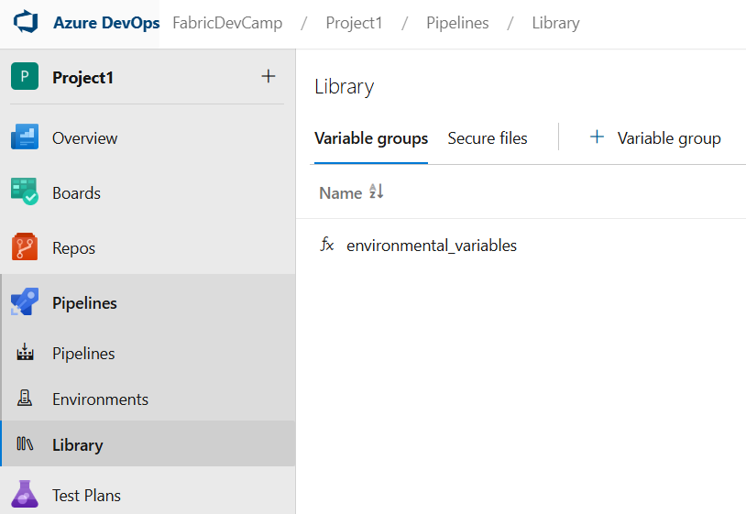
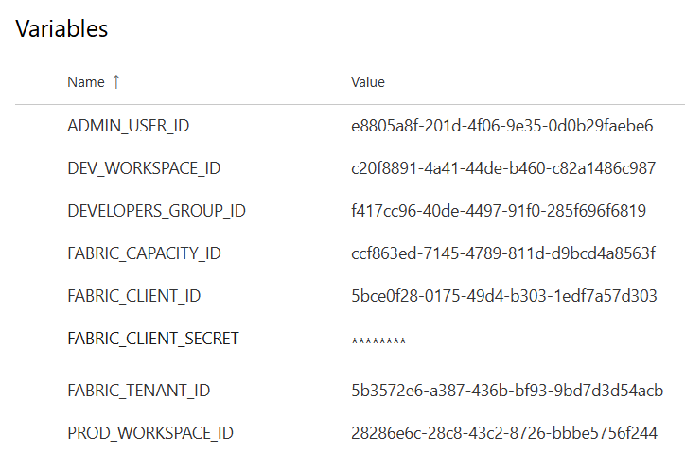

Slide 36
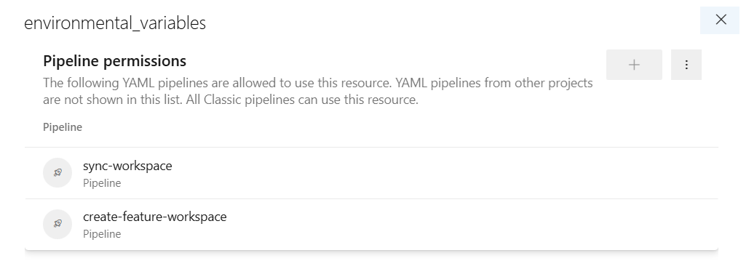

Slide 37
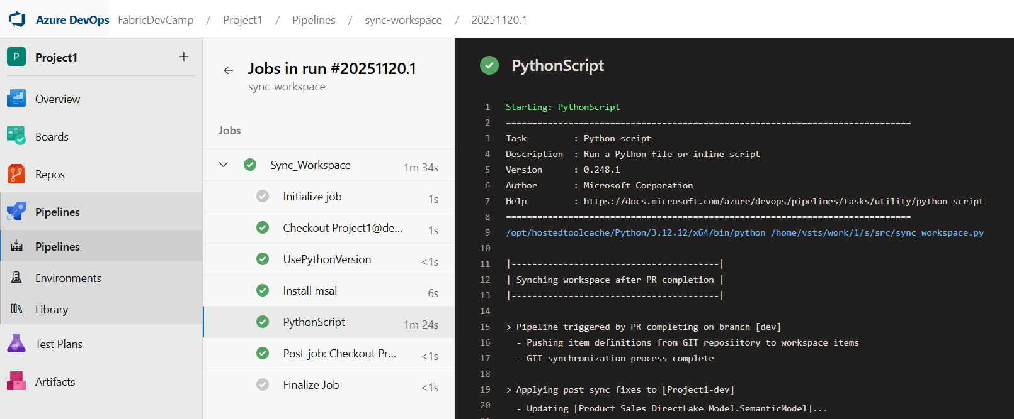

Slide 38
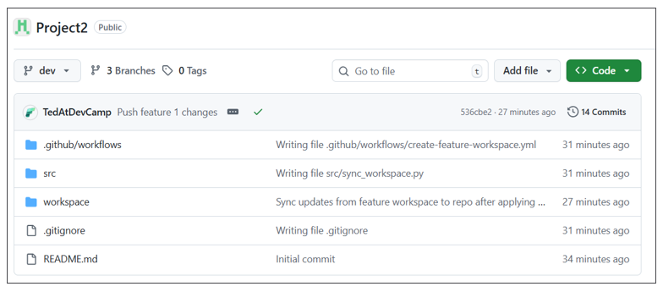

Slide 39
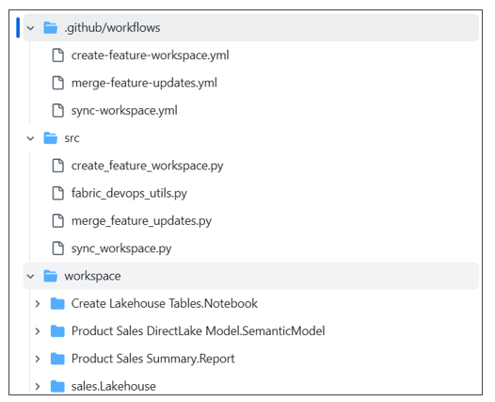

Slide 40
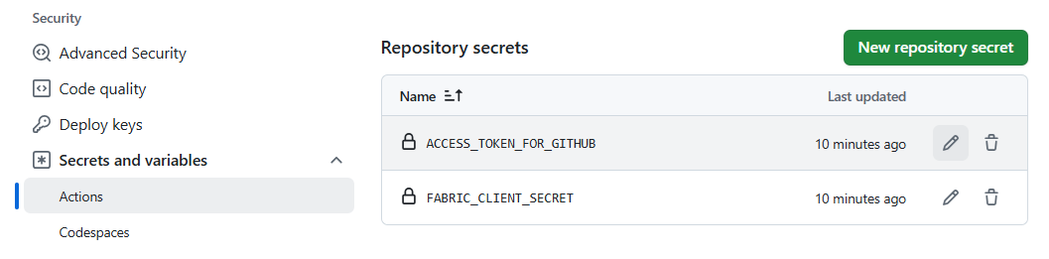

Slide 41
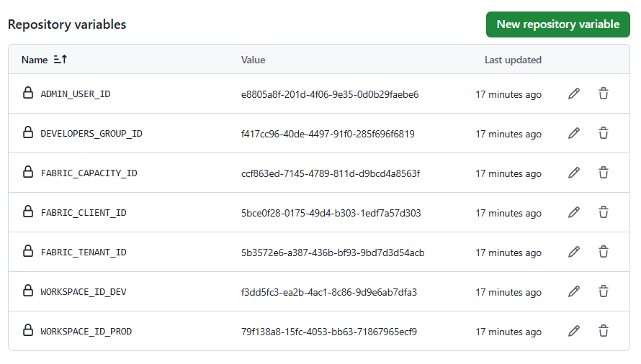

Slide 42
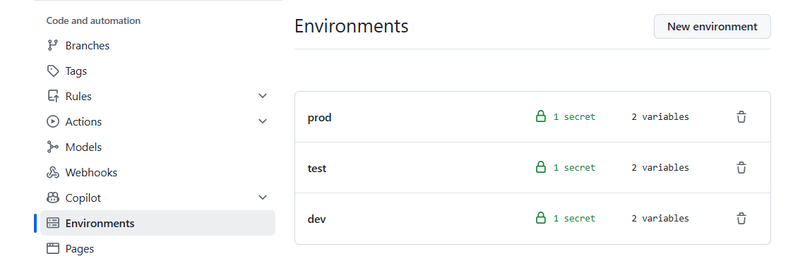

Slide 43
